Slide 1
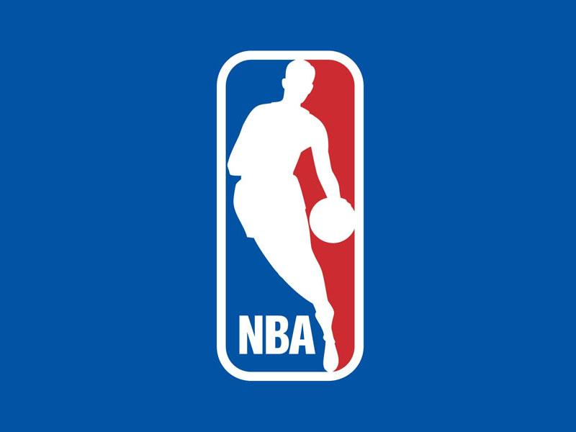
Predicting NBA Champions with Machine Learning
By :
Bhavya Jayaprakash
Darren Holzhausen
Noah Dolan
Notes:
Bhavya

Slide 2
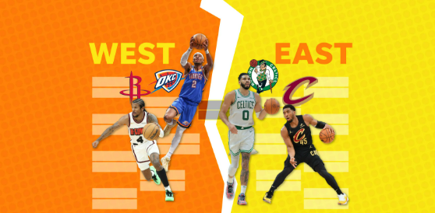
Why NBA?!
🌍 Global Popularity
The NBA is the premier professional basketball league with 30 teams and a worldwide fanbase.
💰 Massive Economic Impact
Generates over $8 billion annually, reflecting its massive entertainment and business value.
📊 Data-Driven Sport
The NBA is a data-rich environment — tracking detailed team and player stats across every game and season.
This opens opportunities for deep analytics, predictions, and strategy optimization.
🧠 Analytics as the New Coach
Teams now use predictive models to shape gameplay — from player rotations to shooting decisions.
Data has become a crucial strategic tool, like having an extra assistant coach on the sidelines.
Notes:
Bhavya

Slide 3
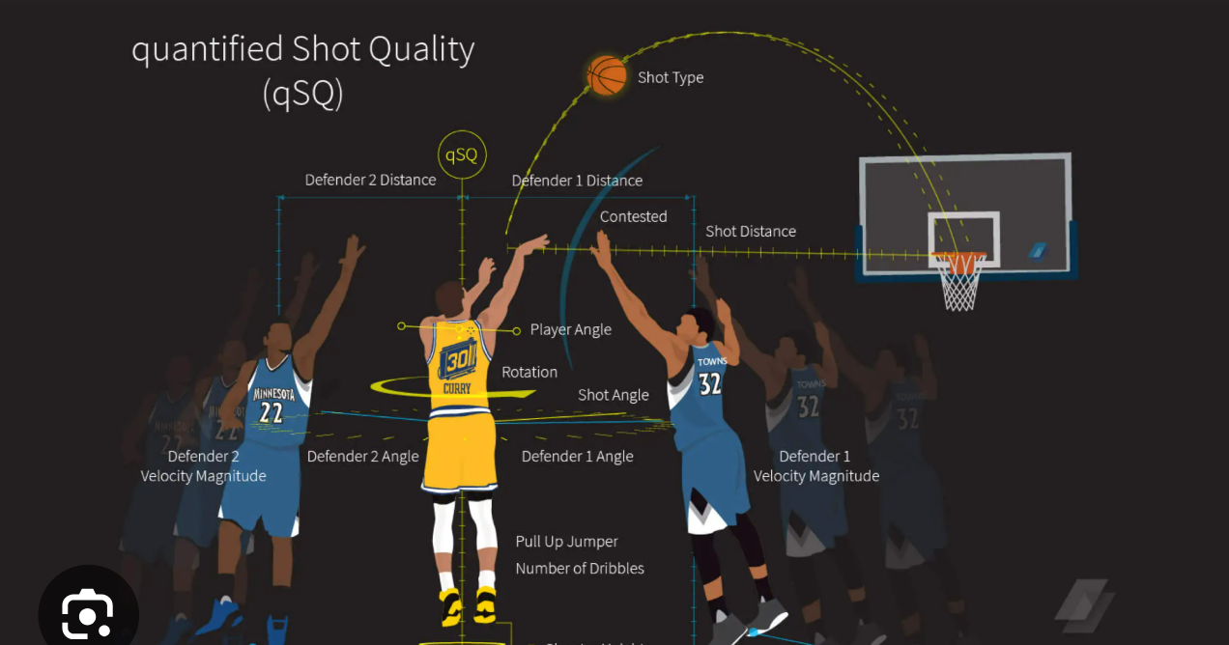
How is Data Science helping the NBA
🔍 Smarter Decision-Making
NBA teams now rely heavily on data analytics to gain every possible edge.
From player performance to in-game strategy, analytics guide crucial decisions.
🧠 From Intuition to Insight
Coaches and managers use advanced statistics and models to evaluate matchups, optimize lineups, and refine tactics.
Informed decisions replace gut instinct, improving consistency and outcomes.
🎯 Predictive Modeling & Betting
The rise of legal sports betting adds a new dimension to analytics.
Accurate models can predict game outcomes, making the process more transparent and equitable for fans and bettors alike.
Notes:
Bhavya

Slide 4

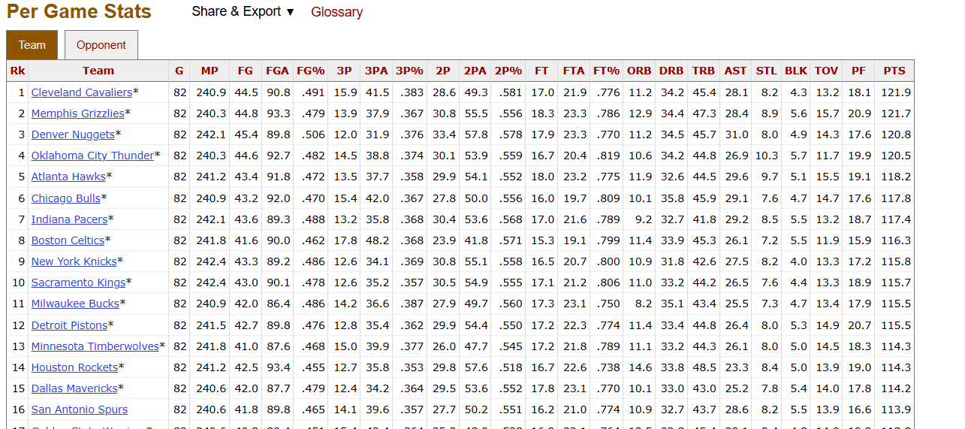
Data Collection
https://www.basketball-reference.com/leagues/
Notes:
Bhavya

Slide 5
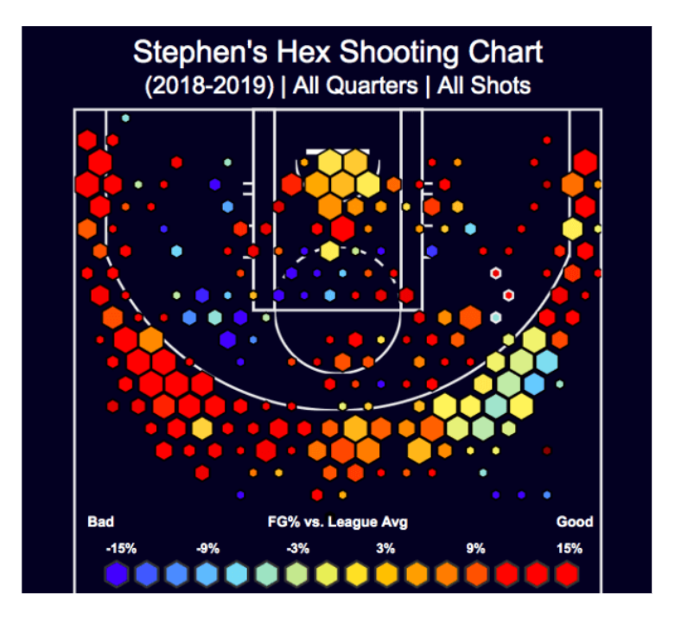
FUN FACTS
The 3-point line was first introduced into the NBA in the 1979–1980 season but only around 1993–94 three point attempts started to rise. Shortly after Stephen Curry’s arrival in the 2010 season, the NBA world realized that shooting more three-pointers was part of a winning strategy. Teams throughout the league started to put more priority on the three point shot.
NBA has installed six cameras in every Basketball court to collect granular data on players’ movements. This data is being analyzed by machine learning models to recommend the winning strategy accordingly. The picture shows Breakdown of how Stephen Curry fairs against the rest of the league when taking shots from certain areas of the court.
Notes:
Darren

Slide 6
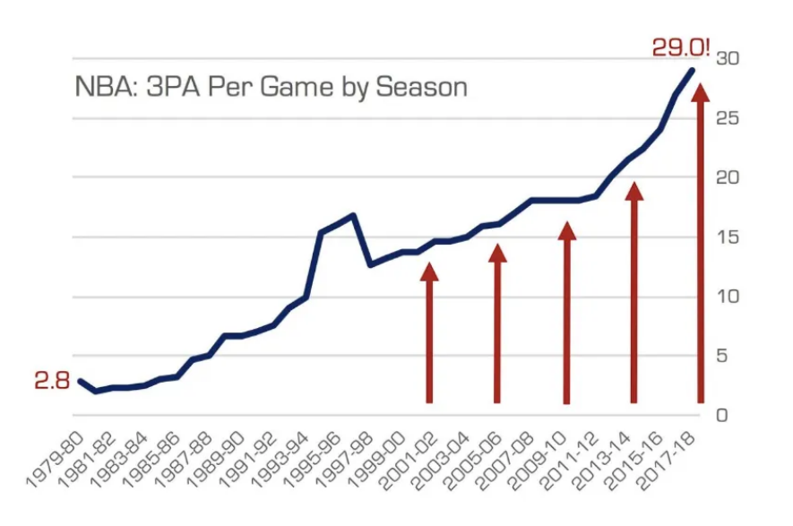
Why 2014 - 2025?
The rise of 3-point shot attempts and the percentage at which they are being shot is having a major impact on the game as we know it.
The arrival of sharpshooters like Stephen Curry, Klay Thompson, James Harden, and Damian Lillard around the year 2014 changed the game and now the 3-point shot has become a cornerstone of the offense.
Notes:
Darren

Slide 7
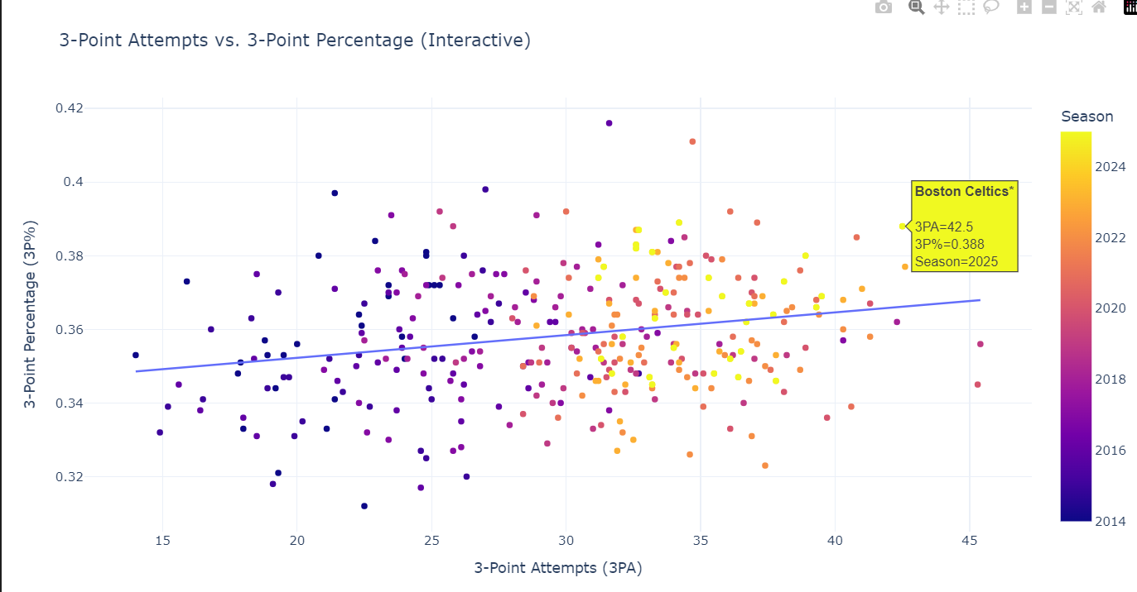
Interactive 3PA vs 3P% Scatter Plot
3pa_vs_3p_percent.html
Notes:
Darren - This chart visualizes the relationship between how often teams attempted 3-point shots and how efficiently they made them.
Here we have an interactive scatter plot that compares each NBA team's 3-point shot attempts (3PA) on the x-axis with their 3-point shooting percentage (3P%) on the y-axis.
Each dot represents a team from a specific season between 2014 and 2024. The color gradient helps distinguish different seasons — allowing us to see how 3-point strategies evolved over time.
Instead of cluttering the graph with labels, we made it interactive — so when you hover over any point, you can instantly see the team name, season, number of 3-point attempts, and accuracy.
We notice that over the years, teams have generally increased their 3-point attempts, with varying levels of efficiency. The regression line gives us a subtle trend — teams that shoot more don’t always shoot better, but some manage both high volume and high efficiency, which is often a recipe for playoff success.
This visualization supports our hypothesis: the NBA has shifted toward a 3-point heavy style of play, but there’s still a strategic balance between volume and accuracy.

Slide 8
Machine Learning Model - Random Forest and Linear Regression
📉 Linear Regression
Highlights linear relationships between stats and wins.
Field Goal % and 2-Point % had the strongest positive coefficients, indicating a direct positive impact on winning.
Great for interpreting how each feature influences the target (wins) — direction and strength are clear.
However, it may miss complex, nonlinear patterns present in the game dynamics.
🌲 Random Forest
A more flexible and powerful model for prediction.
Captures nonlinear relationships and interactions between variables that linear models can’t detect.
Provides feature importance, revealing which stats contribute most to predicting wins — regardless of whether the influence is linear.
Ideal for accuracy-focused predictions where interpretability can be balanced with complexity.
Notes:
Bhavya

Slide 9
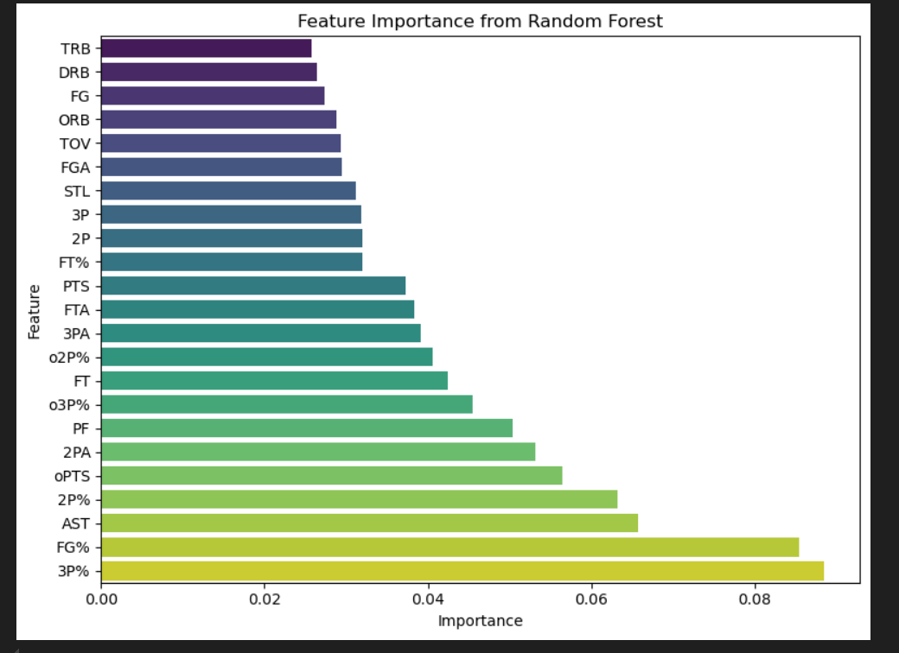
In a Random Forest model, feature importance shows how much each variable contributed to making accurate predictions. It reflects how often and how effectively a feature is used in decision splits across the trees.
Notes:
Noah: Backs up our theory that 3 point shooting is the most important part of modern basketball

Slide 10

Explanation of Moneyline
Moneyline is a way to express betting odds — it tells you how much you’d win (or need to bet) based on how likely a team is to win.
Here's how to read it using your chart:
A negative number (like Boston Celtics -171) means they're the favorite. You’d need to bet $171 to win $100.
A positive number (like OKC Thunder +270) means they’re the underdog. A $100 bet would win you $270.
So, on the next slide, comparing our "Super Accurate NBA Index" to the "Bet MGM Index" shows where the model agrees or disagrees with public betting odds.
Notes:
Noah

Slide 11

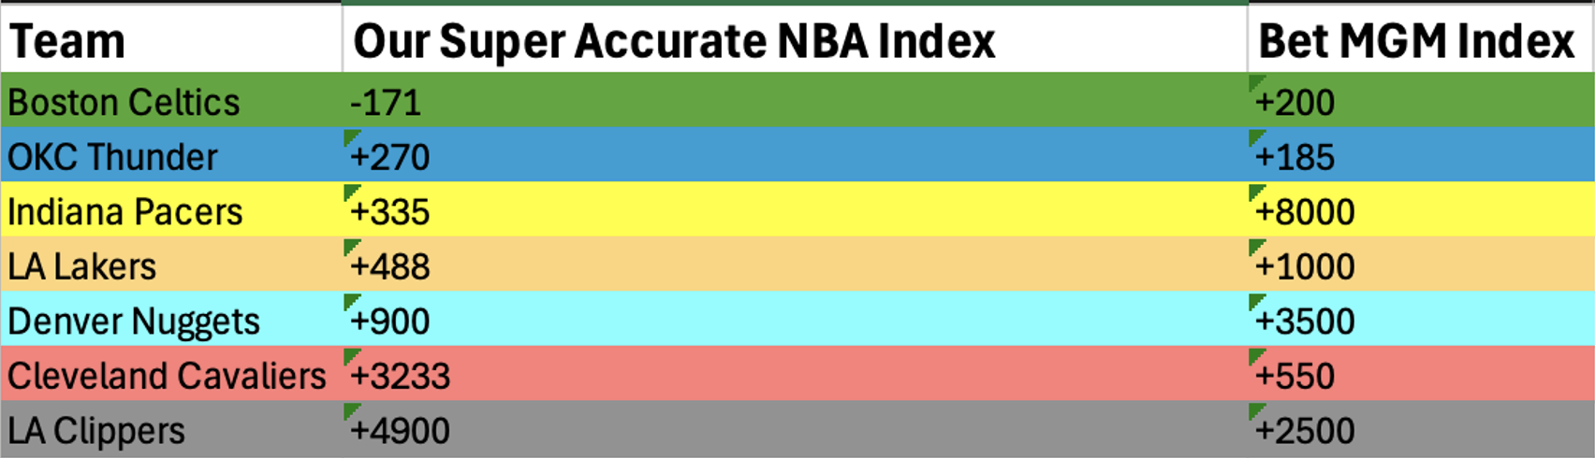

Ready to Take our Model to Vegas???
Notes:
Noah

Slide 12
Why Our Model’s Odds are Different from MGM
No Market Bias
Our model is purely statistical, while sportsbooks adjust odds based on where the money is going — not just on actual chances.
This is how they protect themselves from large losses.
Example: LA Clippers might have a lot of fans who place bets on them because they are a popular team. This moves the odds to be lower (less positive ie more likely to happen according to MGM). Where our model is stagnant according to full team statistics
We did not take into account Playoff matchups
Example: Some team’s might have had a playoff matchup that would be seen as more difficult in the eyes of the Vegas oddsmakers because of how they fared against each other in the regular season
For example, if the Lakers played unusually poorly against Minnesota in the regular season, Vegas might set LA’s initial Championship odds lower because that is their first round matchup
Notes:
Noah

Slide 13
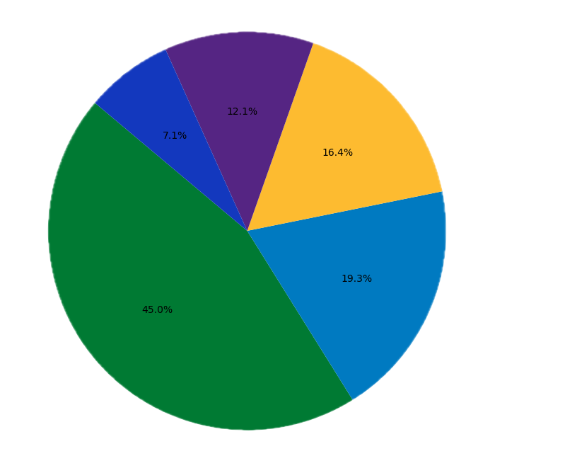
Our 2025 NBA Championship Percentage Chances
Lakers
Team Titles Won
Celtics 18 - Defending Champs
Lakers 17 - Lebron + Luka
Nuggets 1 - 2023 Champs
Thunder 1* - SGA - MVP Favorite!
Pacers 0 - Looking for first title!
Nuggets
Pacers
Thunder
Celtics
Notes:
Darren

Slide 14
Data Pros/Cons - Team Statistics(2014- 2025)
✅Pros
Comprehensive: Covers a wide range of team-level stats (shooting, assists, defense, etc.) Consistent Format: Uniform structure of data across all seasons Public & Free: Easily accessible without needing API keys or paid subscriptions Trusted Source: Widely recognized in sports analytics for its reliability
⚠️ Limitations Manual Downloading: Requires manual downloads — not API-driven
Incomplete Data: The data does not account for in-season trades or injuries for players towards the end of the season or in the playoffs.
Notes:
Darren

Slide 15
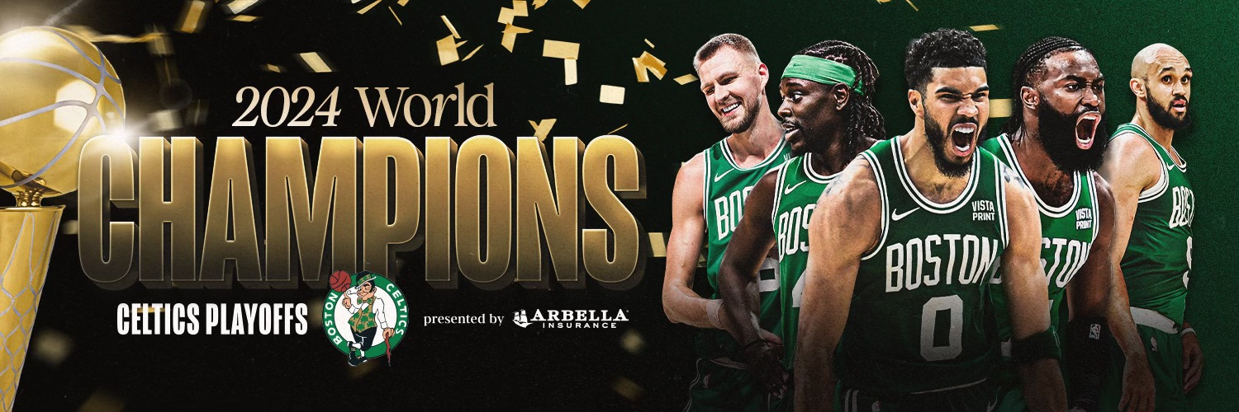
And Remember… if you want free money, bet on the Boston Celtics for 2025 NBA Champions*
*Gambling problem? Call 1-800-GAMBLER
Notes:
Darren

Slide 16
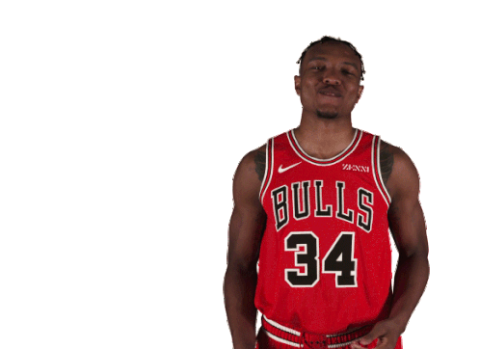
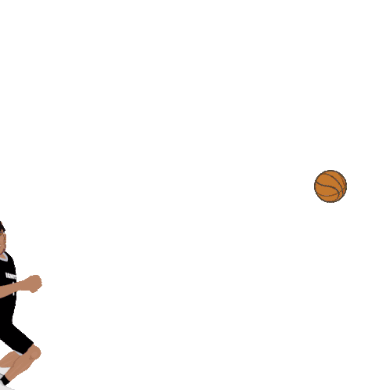
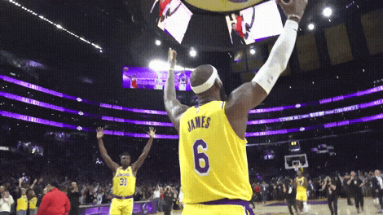
Any questions?

